Slide 1


Enhancing Aviation Safety: Insights from Accident Data Analysis
‘A Data-Driven Approach to Improving Safety in Aviation’
Presented by : Evelyn Wanjiku
Date : 24th November 2024

Slide 2
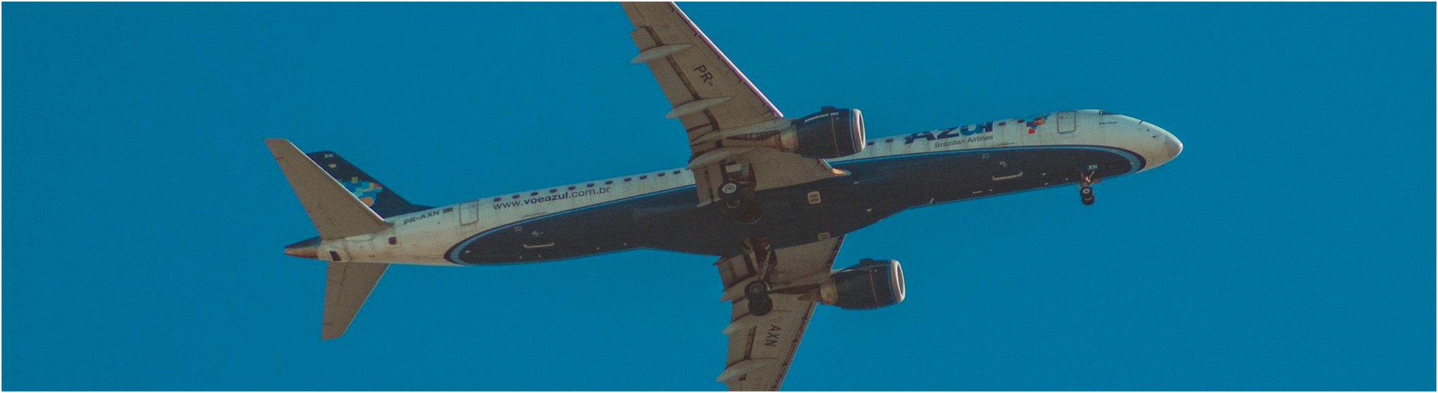
WELCOME TO MY PRESENTATION

Slide 3
The sole purpose of this presentation is analysing aviation accident data to identify safety trends and potential areas of improvement.

Slide 4
TARGET AUDIENCE
1.Who will be receiving your presentation, and what is their role in the company?
The presentation will be received by mid-level and senior managers in the aviation safety or operations departments who oversee safety protocols, regulatory compliance, and risk management
2.What is their background: technical or non-technical?
They have a mixed background, with some technical understanding of aviation safety but not necessarily deep expertise in data science or analytics.
3.How will your presentation affect their work or a decision they need to make?
The presentation will inform their decisions on safety protocol enhancements, pilot training, maintenance prioritization, and potential investments in predictive safety technologies.

Slide 5
4. What is their attention span?
They likely have a moderate attention span, favoring concise, impactful insights over technical detail due to their need to make strategic, data-informed decisions quickly.
5. What is the goal of the presentation?
The goal is to convince these decision-makers that data-driven insights from the analysis can enhance safety protocols, reduce accident risks, and improve response to high-risk conditions, justifying potential updates in safety practices or training programs.

Slide 6

IMPORTANCE OF SAFETY IN AVIATION
To protect and save human lives
To maintain public trust in air travel
To reduce on costs
All this involves minimizing risks associated with mechanical failures, environmental conditions, and human factors, as well as requiring continuous analysis and adaptation of safety protocols.
O
.

Slide 7



Business context
Problem Statement: Safety is a top priority in the aviation industry, but incidents still occur. Our goal is to reduce risks by identifying trends in aviation accidents and injuries.
Objective: Help stakeholders understand accident patterns and make informed decisions to enhance safety.
Audience Impact: For management and policy-makers, this analysis can support decisions on safety protocols and investments in risk mitigation.

Slide 8

DATA COMPLETENESS
Note missing data points, e.g., many entries lack :
Latitude
Longitude
Airport Code
Aircraft Category
DATA SUMMARY
The aviation dataset records incidents in the US. From it, we get insights into factors that contribute to accidents, enabling data driven improvements.
DATA FIELDS
Location
Accident Number
Event Date
Severity of Injuries
Aircraft Damage
Flight Phase
Weather Condition

Slide 9
DATA PROCESSES
Data cleaning - finding and handling missing data
Explanatory Analysis-Analysed trends such as injury severity, damage levels and phases of flight associated with accidents
Analysis techniques –such as distribution analysis of injury severity or damage by aircraft type.

Slide 10
KEY FINDINGS
1. Injury Severity patterns
The distribution of accidents by injury severity revealed that fatal injuries are relatively rare, but serious and minor injuries are more frequent.
A significant number of accidents occurred during critical flight phases such as takeoff and landing, where injury severity tends to be higher.
A correlation between adverse weather conditions (e.g., poor visibility, thunderstorms) and higher injury severity was observed.
Weather appears to play a major role in accidents that result in serious and fatal injuries, highlighting the importance of weather-related safety protocols.

Slide 11
2. Aircraft Damage and Categories
Aircraft damage levels varied, with a higher frequency of moderate to severe damage in accidents involving smaller or private aircraft.
Larger commercial aircraft tended to sustain minor
damage in the majority of cases.
Certain aircraft types and models, particularly older or smaller planes, were more frequently associated with higher damage and injury rates.
This suggests that aircraft age and maintenance status may be significant factors in accident severity.

Slide 12
3. Environmental Factors
Weather conditions such as fog, rain and strong winds were found to increase the likelihood of accidents, especially during take off and landing phases.
Poor weather conditions correlated to higher accident rates and more severe outcomes.
Accidents in adverse weather conditions resulted in more severe injuries and greater aircraft damage.

Slide 13
EVALUATION AND FUTURE IMPROVEMENT IDEAS
Limitations
1.Missing data - limit the accuracy and comprehensiveness of some analysis.
2. Dataset scope - The dataset covers incidents in the U.S. only, limiting generalizability to international aviation trends.
3.Data recency - If the dataset isn’t updated regularly, findings may not reflect the latest safety technologies, aircraft models, or regulatory changes, potentially reducing the relevance of the insights for current aviation practices.

Slide 14
Future Work and Recommendations
1. Enhance data collection -Future analysis could benefit from a more complete dataset with fewer missing fields. Collecting additional data on factors like maintenance history and pilot experience could also yield more precise insights.
2. Redictive Modeling - Building predictive models using machine learning could help identify high-risk scenarios and predict the likelihood of accidents based on factors like weather conditions, flight phases, and aircraft types.
3. Comparative Analysis - Expanding the analysis to include international aviation data would allow for a comparison of trends across regions, providing insights into global best practices and identifying region-specific safety risks.
4. Focus on high-risk conditions - Further research into accidents during high-risk conditions (e.g., poor weather or critical flight phases) could lead to targeted safety recommendations.

Slide 15

CONCLUSION
These findings underscore the potential for enhancing safety protocols, improving pilot training for high-risk conditions, and reinforcing maintenance standards.
By applying these data-driven insights, the aviation industry can work toward minimizing risks and reducing injury severity, ultimately making air travel safer and more reliable.

Slide 16

THANK YOU!

